Slide 1
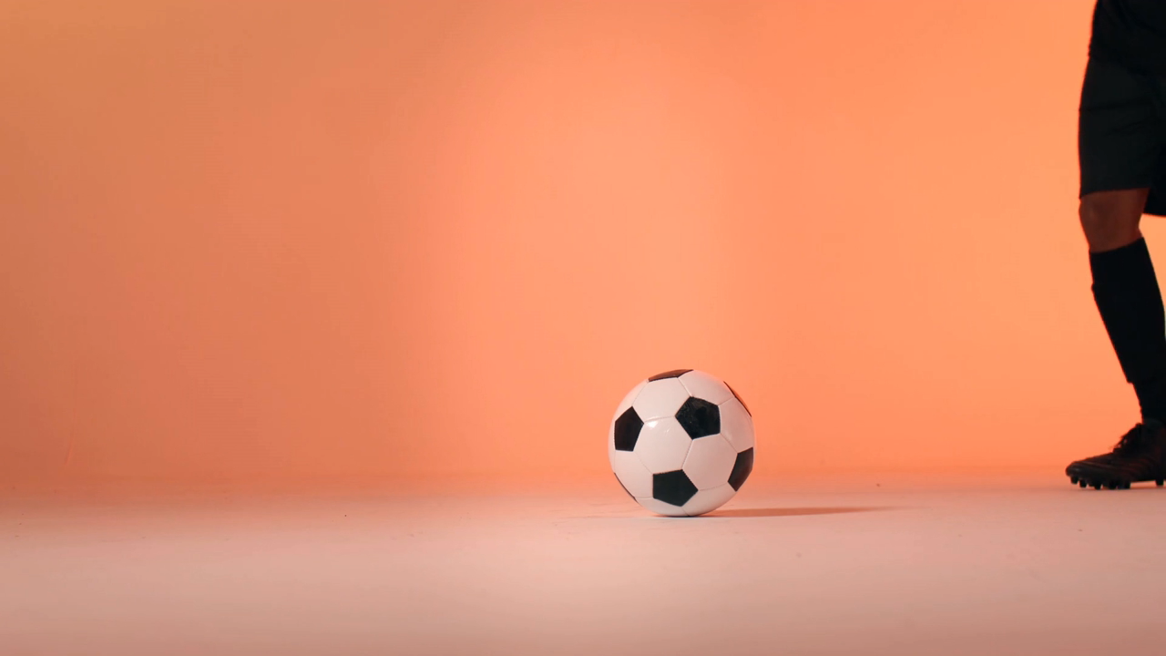

Decoding Football
Data-Driven Exploration of
Football Performance and Market Trends

Slide 2
BRIEF OVERVIEW
What is the average attendance for matches at different stadiums?
How does stadium location influence match outcomes?
Attendance Patterns: Does day of the week and match round influence match attendance?
Fan Engagement: Which matches (competitions, rivals) bring in the most fans, and how can we capitalize on this through promotions?
What are the differences in team performance based on manager names or strategies?
Which teams have the best win/loss ratio in various competitions?
How do teams’ performances vary across different seasons and competitions?
What are the contract expiration dates, and how do they align with market value trends?
Which players are nearing the end of their contracts and might need renewal?
What is the agent representation of the players?
Which players come off the bench and contribute to goals/assists?
Are certain players regularly substituted ?
How do teams’ substitution patterns vary ?
Which positions are most frequently substituted ?
What are the most common events recorded (goals, yellow cards, red cards)?
How do events like goals, fouls, or cards influence the final score?
How do goals scored before halftime affect the team’s chances of winning?
What minute of the game sees the most significant events (e.g., goals, substitutions)?
How does a team's performance vary between different competitions?
How do team performance differ across competitions? Which teams have the best record in specific competitions?
How does our team’s performance vary across different competitions (e.g., domestic league, international tournaments)?
How do player attributes (height, foot, position) correlate with performance metrics (goals, assists)?
What is the age distribution of players affect performance?
Are players from certain countries more successful in specific competitions?
Which sub-positions contribute the most to team success (goals, assists, defense)?
How does player age impact their market value?
How does a player’s performance influence their current market value?
Which positions or sub-positions tend to have higher market values?
Is there any correlation between a player's height, market value?
Which players should the club invest in based on future potential and market demand?
How do different referees impact the number of yellow/red cards in matches?
Which referees tend to officiate high-profile matches (e.g., finals)?
Are certain referees associated with higher or lower goal counts?
How does a player's performance vary across different seasons?
On an Average what is the goals and assists for each player?
Which players contribute the most in terms of goals, assists, and minutes played?
Which players have most yellow and red cards?
Contract Management
Analyse player contract data to help clubs manage player contracts and optimize value.
Substitution Patterns
Analyse substitution strategies and their impact on game outcomes.
Competition Analysis
Evaluate team and player performance across different competitions.
Referee Analysis
Examine the impact of referees on match outcomes and team performance.
Team Comparison
Compare teams based on their performance and managerial choices.
Attendance and Stadium Analysis
Analyze the attendance patterns and stadium influences.
Event Analysis
Explore the key events during matches and how they impact results.
Player Attributes and Demographics
Understand how player attributes and demographics influence performance.
Performance Analysis
Analyse individual player and team performance over various matches and seasons.
Player Profile and Market Value
Understand the player profiles, including their market value trends.

Slide 3
DATA PROCESSING
MISSING VALUE TREATMENT
MEAN, MEDIAN AND MODE IMPUTATION
OUTLIER TREATMENT
USING WINSORIZATION METHOD

Slide 4
PERFORMANCE ANALYSIS – PLAYERS CONTRIBUTION
PERFORMANCE ANALYSIS – PLAYERS CARDS
THIS SHOWS LACK OF SPORTSMANSHIP AND IMPROVEMENT IN GAME NEEDED FOR THESE PLAYERS
CHRISTIAN PULISIC AND KENNY SAIEF OVER PERFORM IN TERMS OF CONTRIBUTION
MOST YELLOW CARDS ARE GIVEN TO TIMOTHY CHANDLER AND JOHN ANTHONY BROOKS
SERGINO DEST AND GIOVANNI REYNA ARE THE MOST CONSISTENT PLAYER IN CONTRIBUTION

Slide 5
PLAYER-MARKET VALUE ANALYSIS
NEGATIVE CORRELATION R = -18 %
POSITIVE CORRELATION R = 30 %
NEGATIVE CORRELATION R = -48 %
POSITIVE CORRELATION R = 24 %

Slide 6
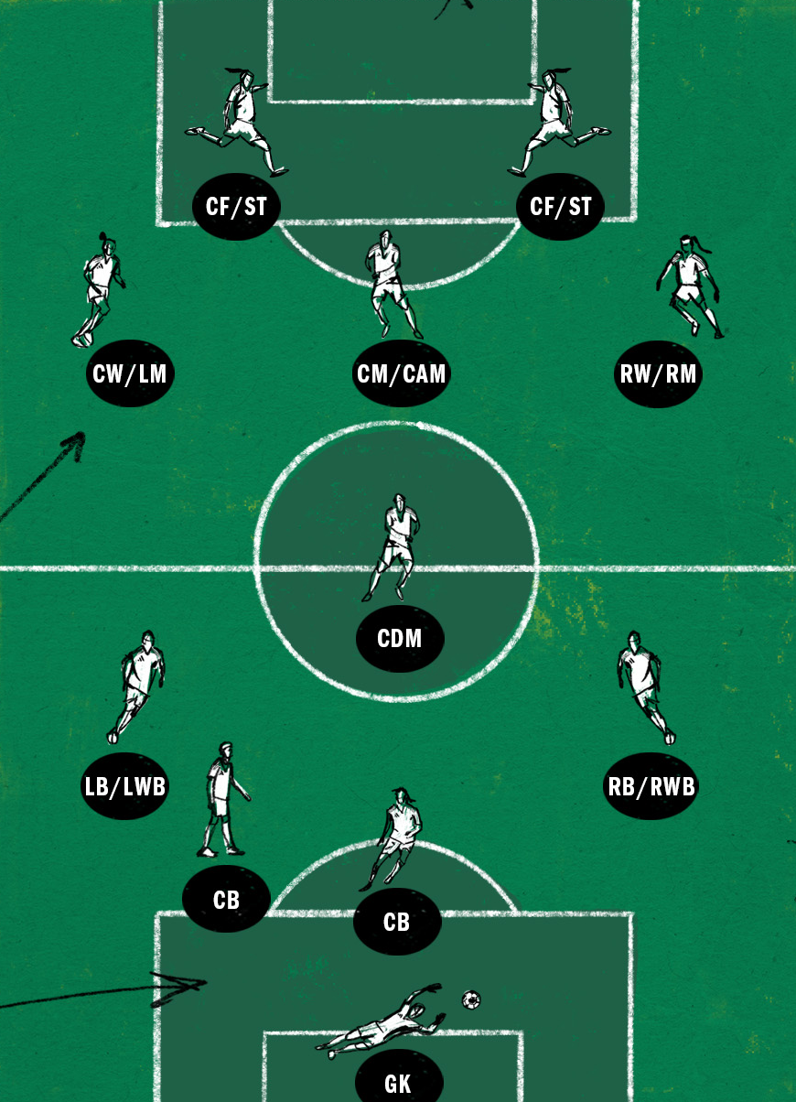
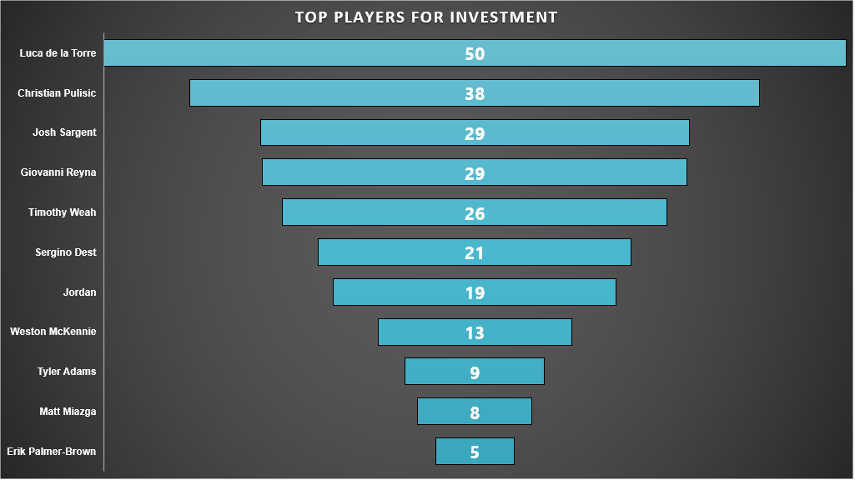
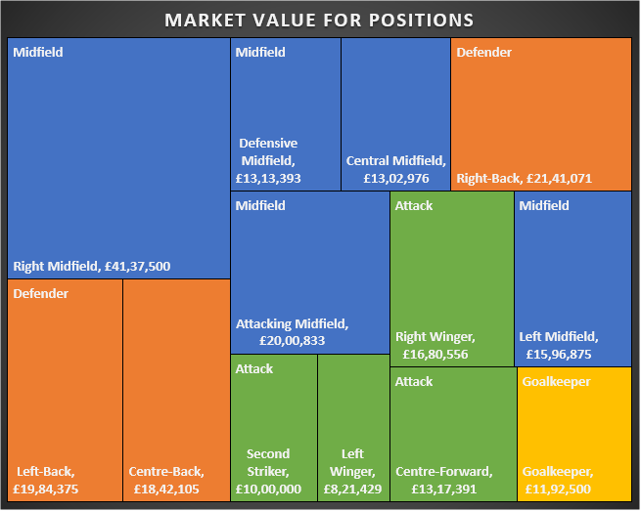
PLAYER PROFILE-MARKET VALUE ANALYSIS
PLAYERS HAVING HIGH POTENTIAL FOR INVESTMENT
PLAYERS VALUE IS BASED ON THE POSITION HE PLAYS
RIGHT MIDFIELDERS ARE PAID THE MOST

Slide 7
PLAYER ATTRIBUTES AND DEMOGRAPHICS
UNITED STATES PLAYERS MOST CONTRIBUTIONS
30 – 35 FOR GOALS 20 – 25 FOR ASSISTS
160 – 170 CM GROUP
BOTH FOOT GROUP
ATTACK GROUP

Slide 8

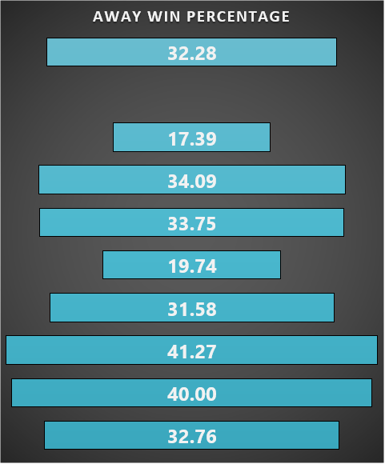
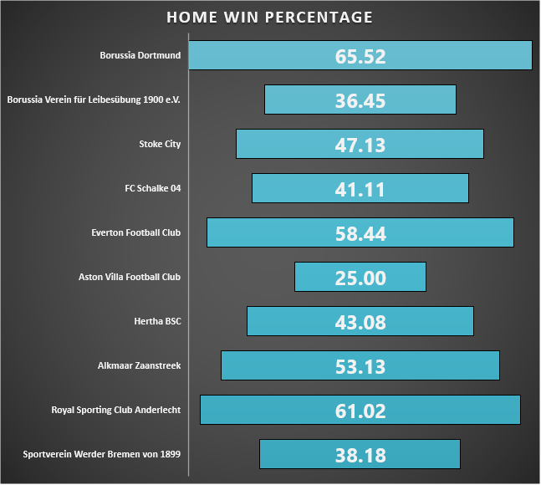
UNDERSTANDING HOME AND AWAY
TEAMS HAVE HIGHER LIKLIHOOD OF WINNING WHEN PLAYING ON HOME GROUNDS
HOME STADIUM AND HOME CLUBS
AWAY STADIUM AND AWAY CLUBS
ABSENCE OF ANY KEY PLAYER REDUCES THE LIKLIHOOD OF THE TEAM WINNING BY ALMOST 40 – 50 %

Slide 9
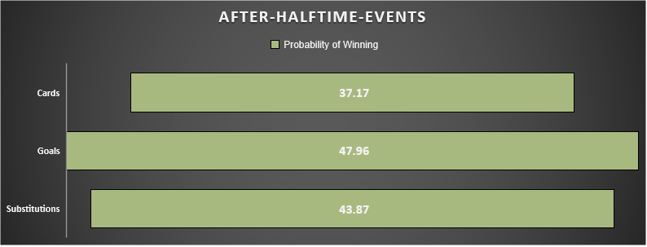
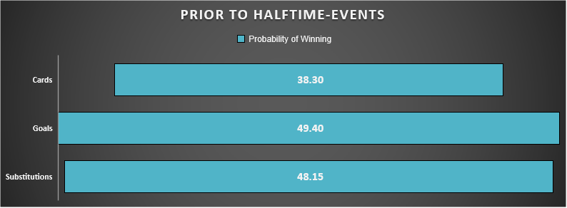
EVENT ANALYSIS EXCEL DASHBOARD
TEAM COMPARISON AND PERFORMANCE EXCEL DASHBOARD

Slide 10
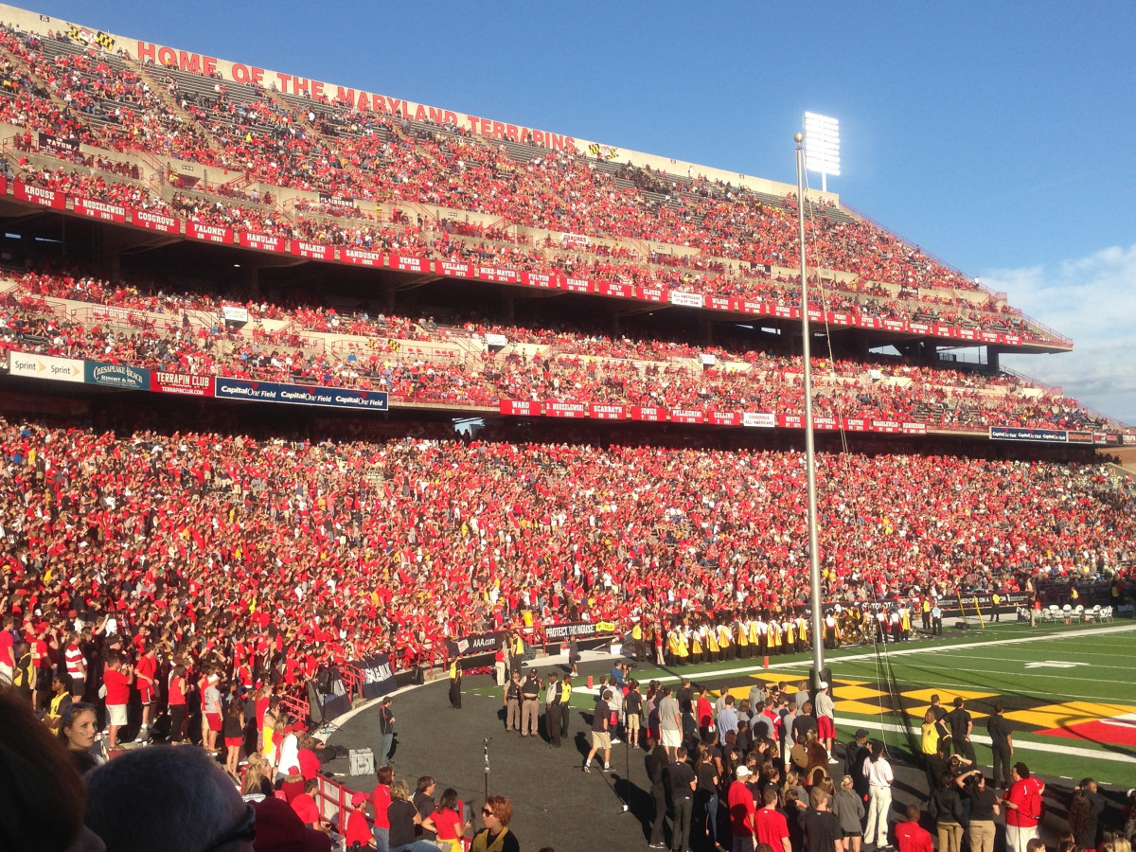
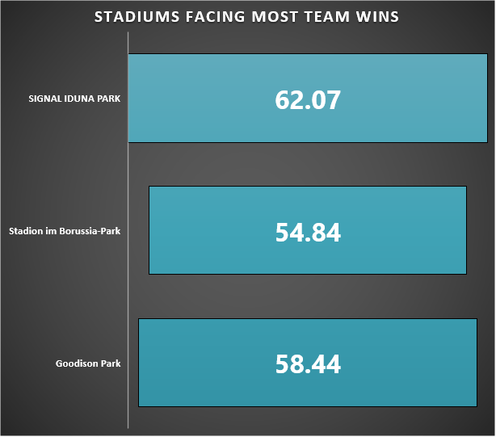
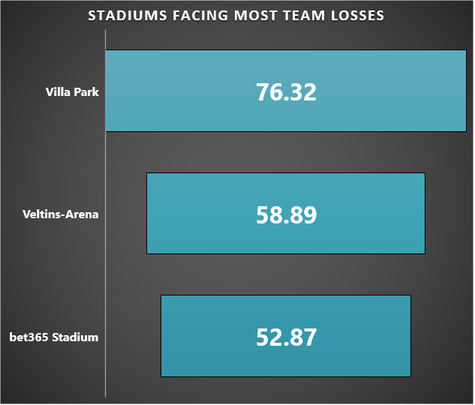
ATTENDANCE AND STADIUM ANALYSIS
STADIUMS OPTIMAL FOR PERFORMANCE FOR TEAMS
IMPROVEMENTS NEEDED IN THESE STADIUM FIELDS
MAXIMUM ATTENDANCE AT HIGH-PROFILE MATCHES
AVERAGING ABOVE 70000 AUDIENCE
BORUSSIA DORTMUND AND MANCHESTER UNITED FOOTBALL CLUB POPULAR CLUBS
MAXIMUM ATTENDANCE AT WEEKENDS

Slide 11
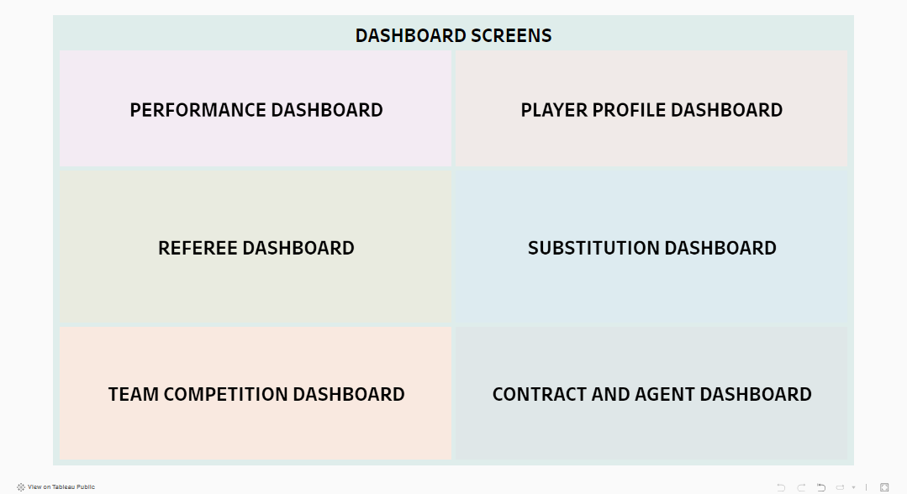
ANALYSIS FROM DASHBOARDS
SHOWS STRICTNESS OF THE REFERREES
STRICT REFERREES REQUIRED IN HIGH PROFILE MATCHES
GOALS SCORED BY SUBSTITUTED PLAYERS BEFORE SUBSTITUTION
COUNT OF SUBSTITUTIONS
REFERREES HAVING MORE GOALS SCORED
TEAM SUBSTITUTION PATTERNS
SUBPOSITION WISE PATTERN
Tableau Public Dashboard Link

Slide 12
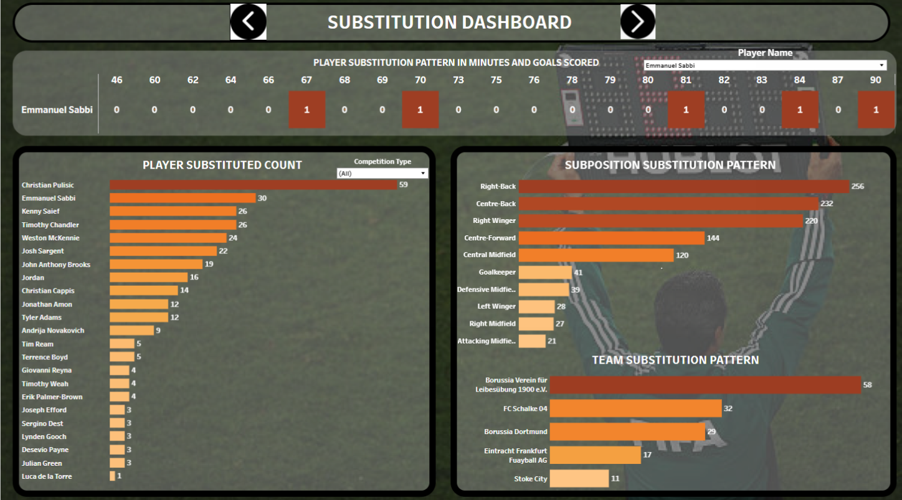
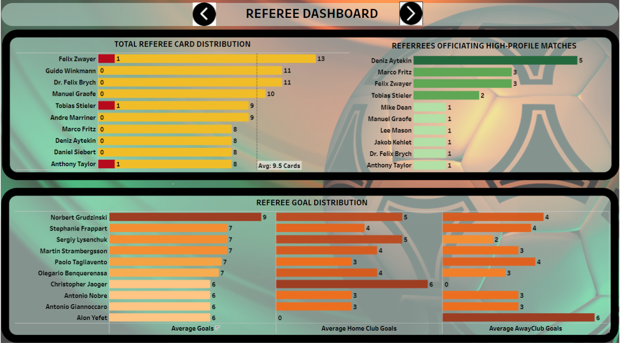
ANALYSIS FROM DASHBOARDS
SHOWS STRICTNESS OF THE REFERREES
STRICT REFERREES REQUIRED IN HIGH PROFILE MATCHES
GOALS SCORED BY SUBSTITUTED PLAYERS BEFORE SUBSTITUTION
PLAYER SUBSTITUTED COUNT
REFERREES HAVING MORE GOALS SCORED
Tableau Public Dashboard Link

Slide 13
PREDICTING WHETHER A PLAYER RECEIVES A YELLOW CARD OR NOT
LOGISTIC REGRESSION
 |  | ACTUALS | CASES
PREDICTED
CASES | NOT YELLOW CARDS | 271 | 353
 | YELLOW CARDS | 25 | 65
MODEL IS 87 % ACCURATE IN PREDICTING YELLOW CARDS

Slide 14
PREDICTING MARKET VALUES BASED ON THE AGE OF THE PLAYERS
LINEAR REGRESSION
METRICS | ACCURACY
MSE | 0.54
MAE | 0.48
RMSE | 0.68
R SCORE OF THIS MODEL IS 58 %

Slide 15
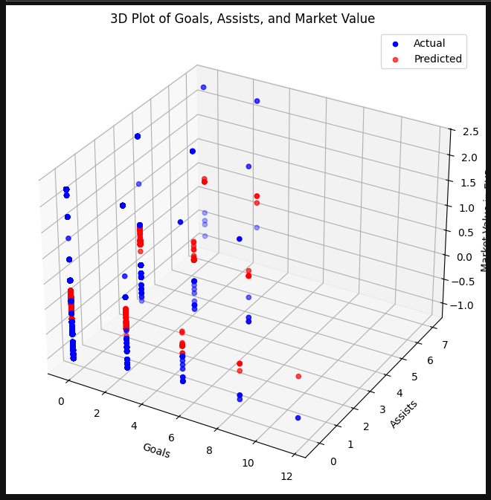
PREDICTING MARKET VALUES BASED ON THE GOALS, ASSISTS AND MINUTES PLAYED BY THE PLAYERS
MULTIPLE LINEAR REGRESSION
METRICS | ACCURACY
MSE | 0.32
MAE | 0.20
RMSE | 0.55
R SCORE OF THIS MODEL IS 76 %

Slide 16
RECOMMENDATIONS
Reduce Yellow and Red Cards by 30%
Increase Fan Engagement Revenue by 20% During High-Attendance Matches
Enhance Contract Renewal Efficiency by Targeting 90% of Key Players
Increase Early-Game Goal Scoring by 25%
Optimize Substitution Patterns to Decrease Unproductive Changes by 40%
Increase Home Win Rate by 15%

Slide 17
CONCLUSIONS
John Brooks and Timothy Chandler lead with 38 and 37 yellow cards respectively, suggesting a 40% higher disciplinary issue rate than other players, impacting team continuity.
High-attendance games featuring teams like Borussia Dortmund and Manchester United generate 25% more revenue per game than average matches, underscoring the financial impact of top-tier fan engagement.
Retaining players with expiring contracts in 2026 is critical, as these key players contribute 60% of team goals and assists, highlighting the importance of contract management in performance retention.
Goals scored in the first 60 minutes correlate with a 1.5x increase in win probability, emphasizing the importance of establishing an early lead.
Frequent substitutions in defensive positions like Right Back and Center Back lead to a 20% drop in defensive stability late in the game, showing the need for strategic adjustments.
Teams with a strong home advantage, such as Barcelona, see a 15% higher goal average in home games compared to away, underscoring the significance of venue-tailored strategies.
Accurate attendance predictions, especially for high-stakes matches, can improve match-day operations, reducing wasted resources by 30% through better planning and staffing.

Slide 18

THANK YOU

